Slide 1
User Requirements and Add-on Software
Commodity accounting software satisfies many small business needs. As business grow their requirement can outpace the software.
A range of add-on solutions are available to service the function shortfalls and provide best of breed features at reasonable cost. This slide deck proposes a process to help understand and fill functional gaps

Slide 2
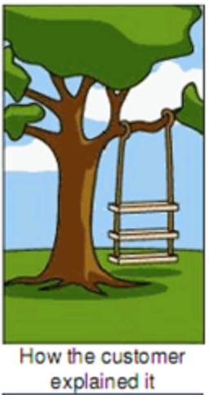
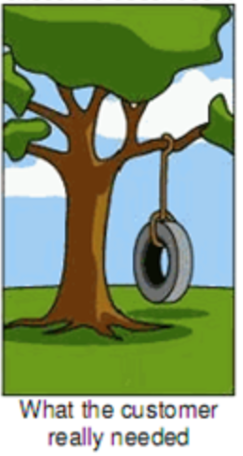
Matching User needs to Software Features
Commodity Software like MYOB
Fantastic value for money
Feature Rich
Business are the NOT the same
Differences in scale
Multi-location complexity
Large vs Small business
Gaps in Functionality need to be understood and addressed

Slide 3
Identify Gap or Requirement Analysis
The Business
Requirements
Functionality
Accounting System
Features

Slide 4
Fill Gap in Requirements
The Business
Requirements
Functionality
Add-On Solutions &
procedures implement
user need
Accounting System
Features

Slide 5
Fully Functional Outcome
The Business
Requirements
Functionality
Add-On Solutions &
procedures implement
user need
Accounting System
Features

Slide 6
Documenting Business Requirements
Requirement :
The name of requirement
Implement
Defer
Description :
Description of requirement
Analysis :
How will requirement be satisfied
Functional Fit :
MYOB
Full Fit
Partial Fit
No Fit
AddOn
Full Fit
Partial Fit
No Fit
References :
Notes, phone mtgs and exhibits

Slide 7
Example Analyse Business Requirements
Requirement :
RA.01 - Increase Profit on Item Sales
Implement
Defer
Description :
Improve profitability on items sales
Analysis :
Options -
1. Reduce Cost
Analyse Supplier volumes negotiate better pricing
Manage stock, cover and lead time reducing inventory cost
Report and manage Day Sales Outstanding (DSO) KPI for Sales Reps
2. Increase Sales
Analyse best customers & sales reps and isolate non performers.
Email sales staff with weekly sales of their customer/product
Provide access to sales reps
3. Seller higher margin product
Analyse customer sales of similar products to cross sell
eg. They buy 250ml Krill Oil and 500ml is better value
Functional Fit :
MYOB
Full Fit
Partial Fit
No Fit
Bi4Cloud
Full Fit
Partial Fit
No Fit
References :
Interview IV.01, exhibits EX.03, EX.04

Slide 8
Fill Gap in Requirements
Add On
Bi4Cloud
The Business
Requirements
Functionality
Add-On Solutions &
procedures implement
user need
Accounting System
Features
Sales Analysis
Debtors
DSO
Inventory
Analysis

Slide 9
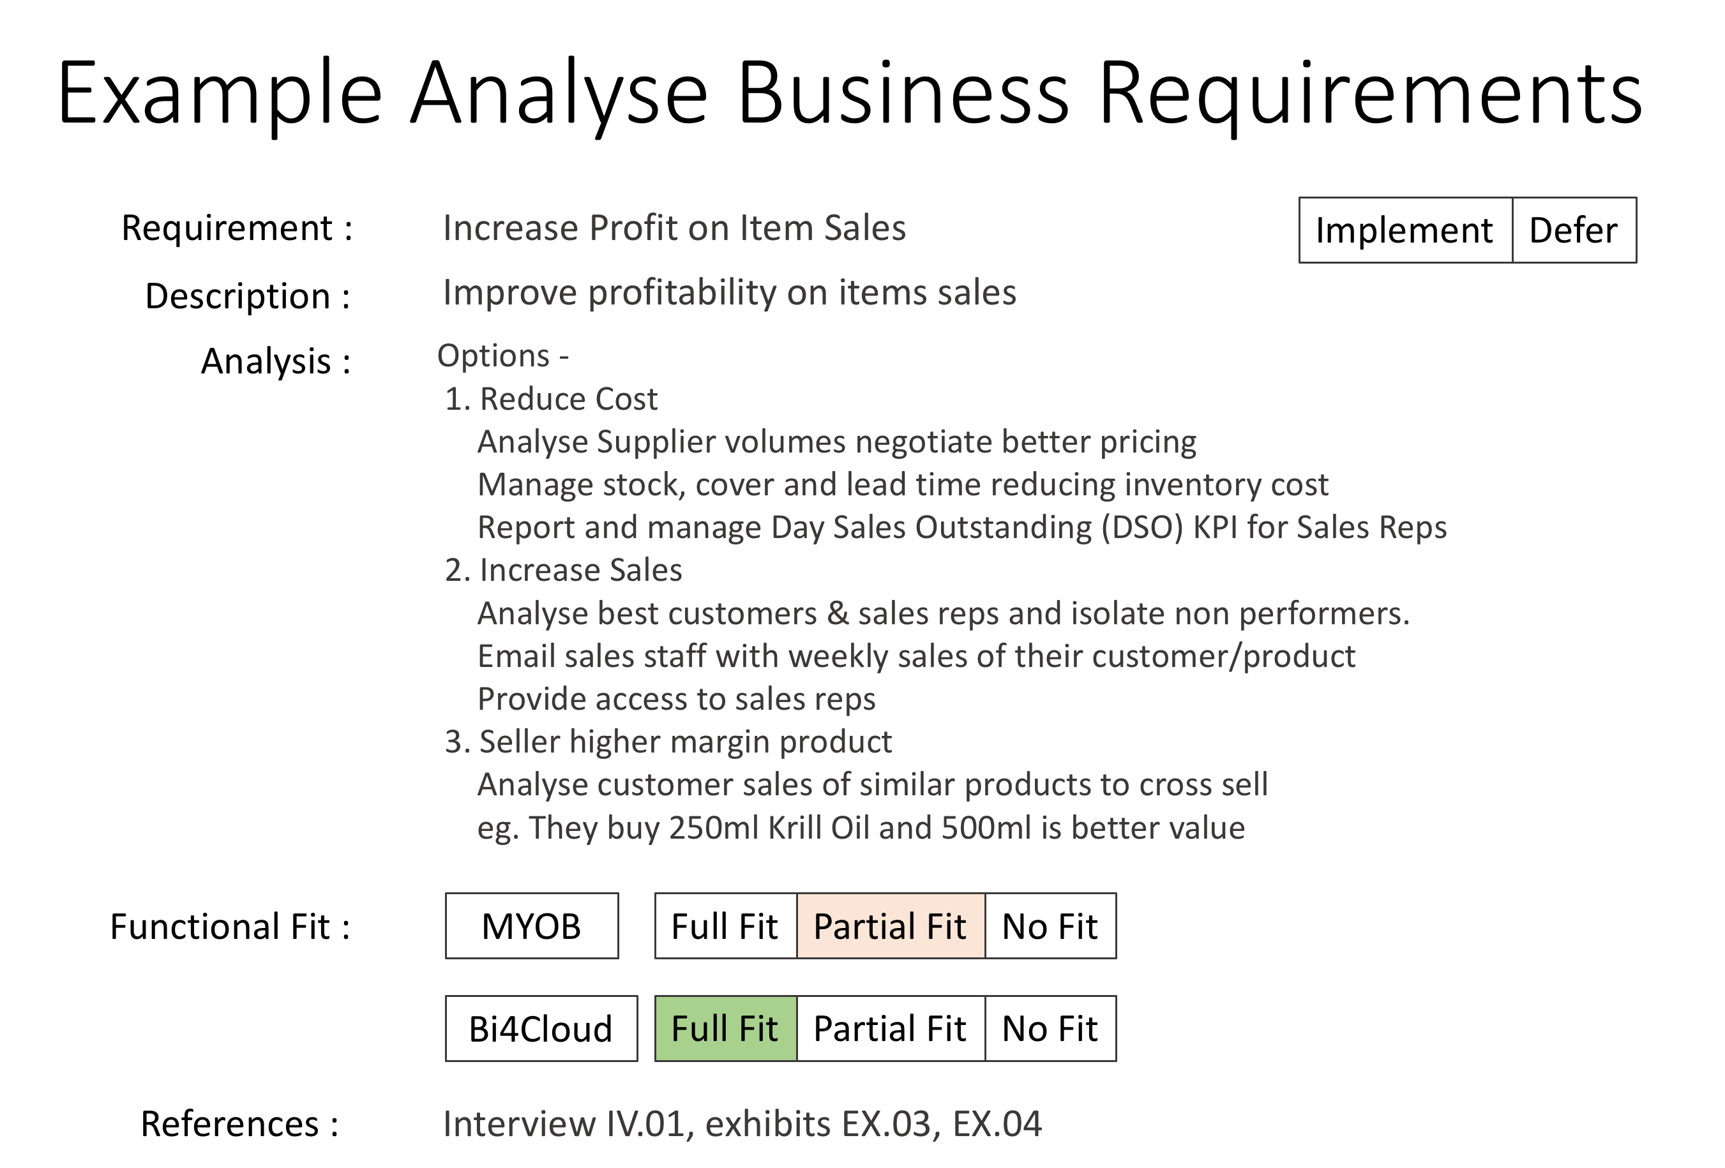
Create Proposal & Support with Analysis
Requirement :
Increase Profit on Item Sales
Proposal :
Manage Inventory, Reduce DSO, Identify and target poor performers
Set KPI :
Categorise stock and set KPIs for each Category
Set targets for reps
Monitor and Report on KPIs
- liquidate poor performance items
- manage poor performance reps
- limit time waste on low value customers
Supported by:

Slide 10
Take-Aways
Understand your clients needs
Don’t force fit what you have
Empathise and respond to their needs
Document and Analyse and Investigate
300 Add-ons at MYOB alone
Don’t jump to what looks good
Choose what meets your clients needs
Create proposals with Supporting Analysis
Reinforces their original need
Creates empathy

